Slide 1
Waymo 2D Detection Challenge by YOLOv3
Group : 朱立宬、徐代晏
2020/06/23

Slide 2
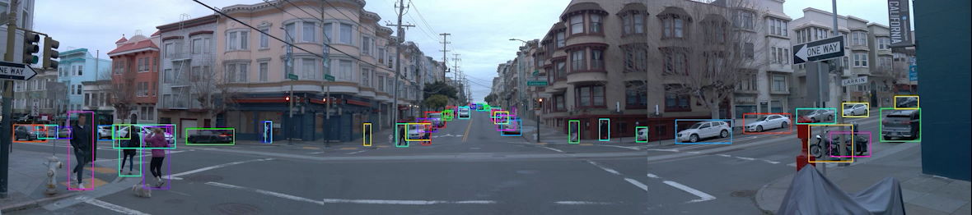
Introduction
Waymo dataset provide 2D bounding box labels in the camera images. The bounding boxes cover only the visible parts of the objects.
There are 4 classes of 2D labels: vehicles, pedestrians, cyclists, signs.
Video for 20 seconds in each TFrecords

Slide 3
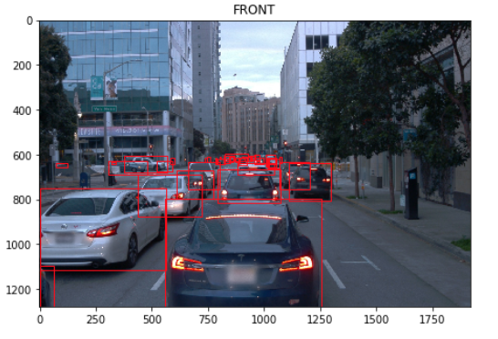
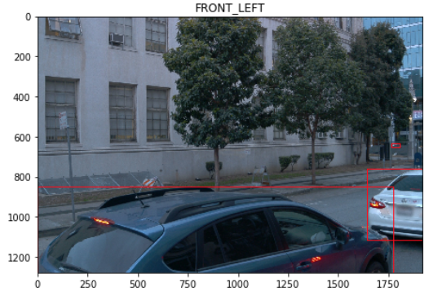
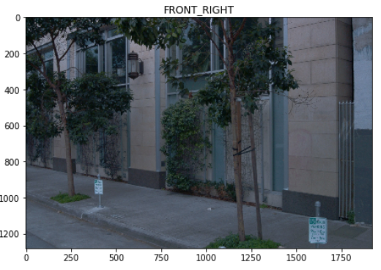
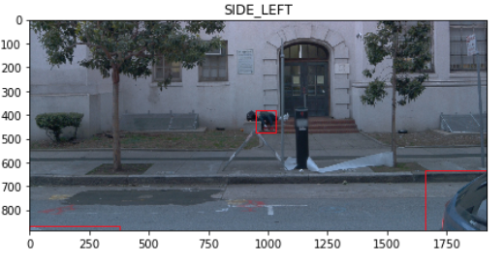
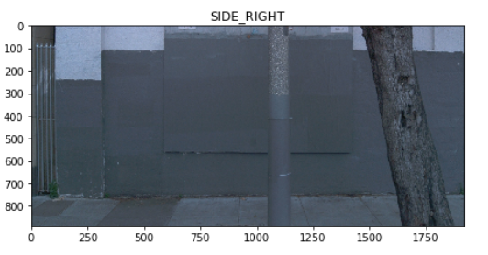
Introduction
The dataset contains images from five cameras associated with five different directions. They are front, front left, front right, side left, and side right.

Slide 4
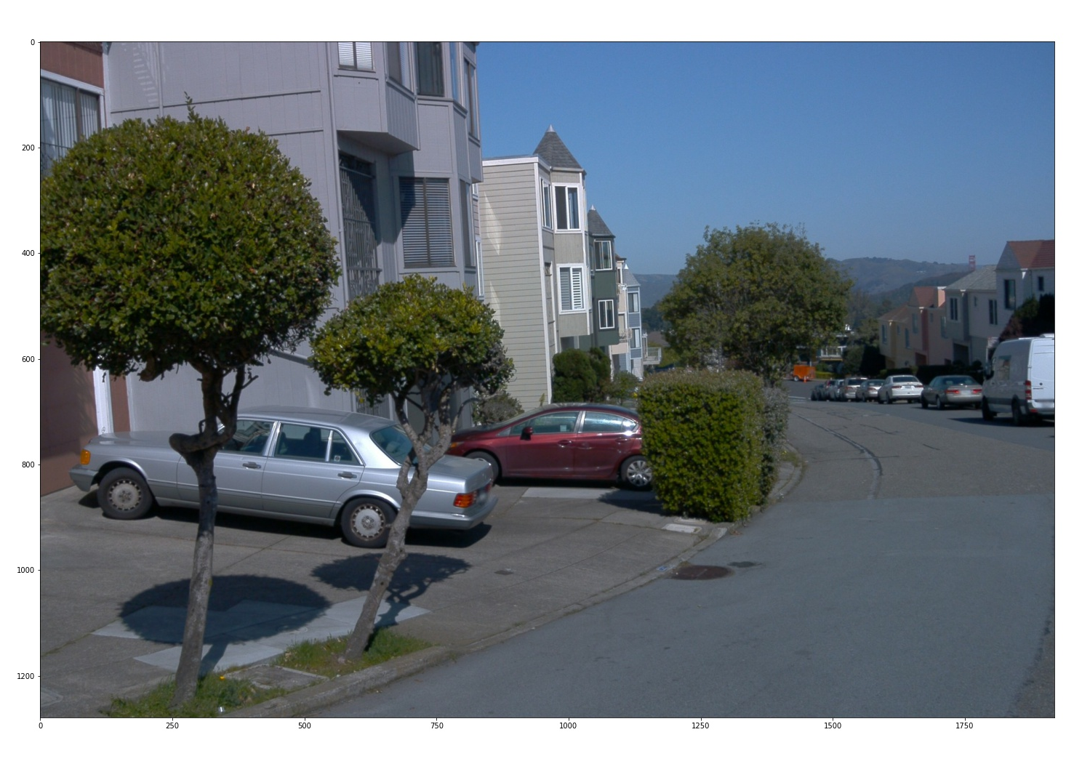
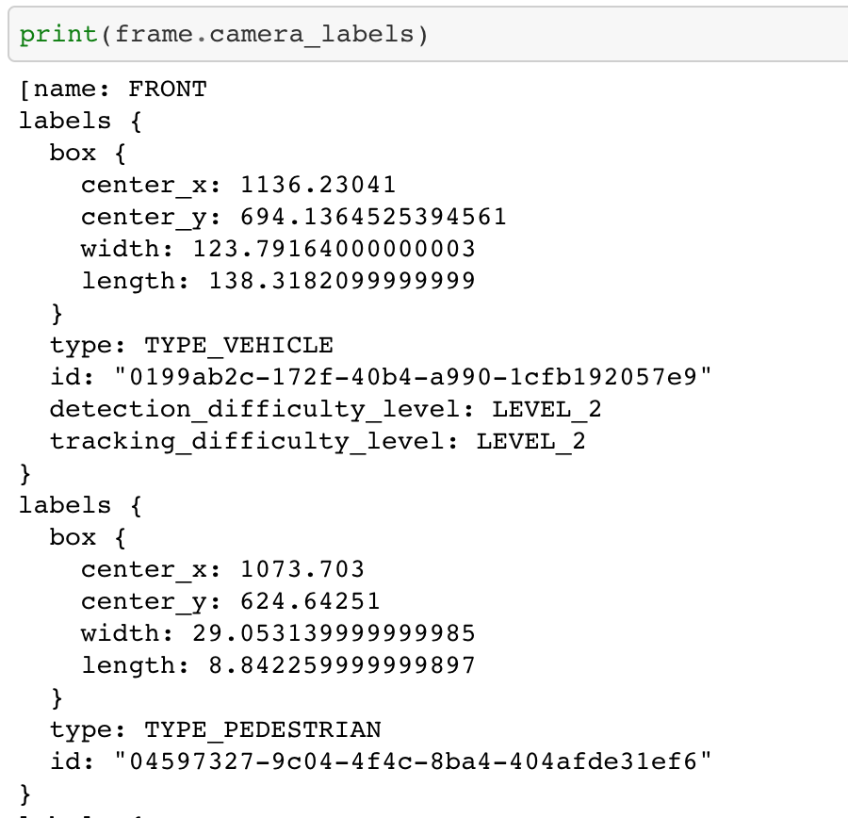
Data Preprocessing - label
Camera data

Slide 5
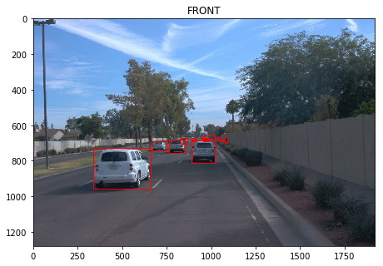
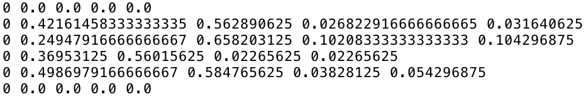
Data Preprocessing
Transform Labels into Yolo Format :

Slide 6
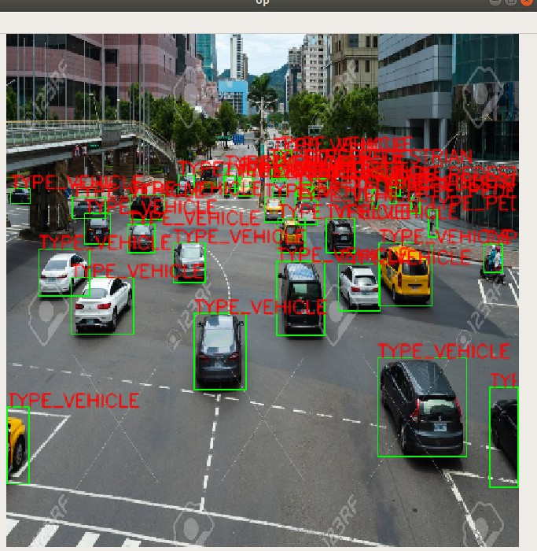
Training model – Yolov3
Advantages of YOLO：
1、Short processing time : 45 fps on Titan X GPU
2、Detecting on global information
3、Learning object generalizable-representations
4、High accuracy

Slide 7
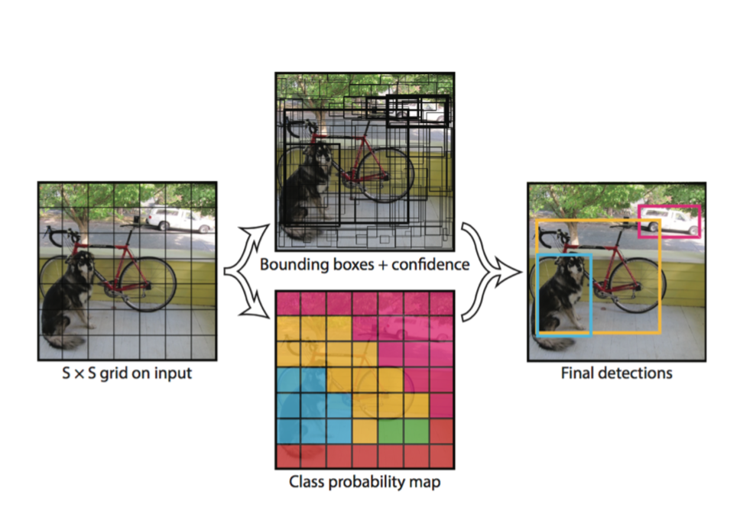
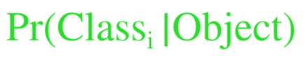
Training model – Yolov3
All Bounding Box, All classes
1) Image → S x S grids
2) grid cell
→ B: Bounding Boxes and Confidence score
x, y, w, h, confidence
→ C: class probabilities

Slide 8
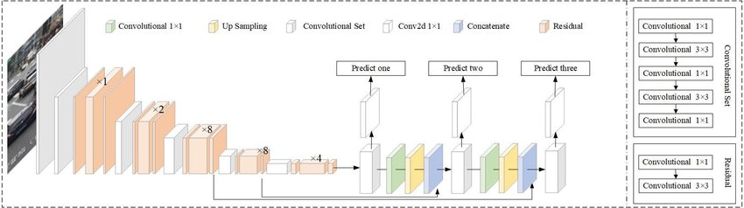
Training model – Yolov3 with Darknet
Advantages of Darknet53 :
Written by C without other dependencies
Support CPU and GPU (Cuda /cuDNN)

Slide 9
Training Strategy
epochs=135
batch_size=64
momentum = 0.9
decay=0.0005
Learning rate=0.001
dropout_rate=0.5
augmentation =[scaling, translation, exposure, saturation]

Slide 10
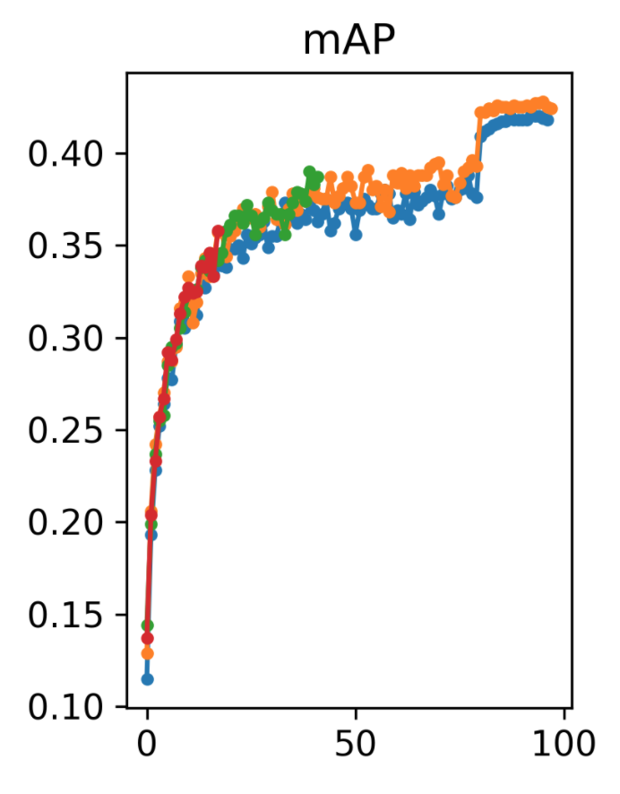
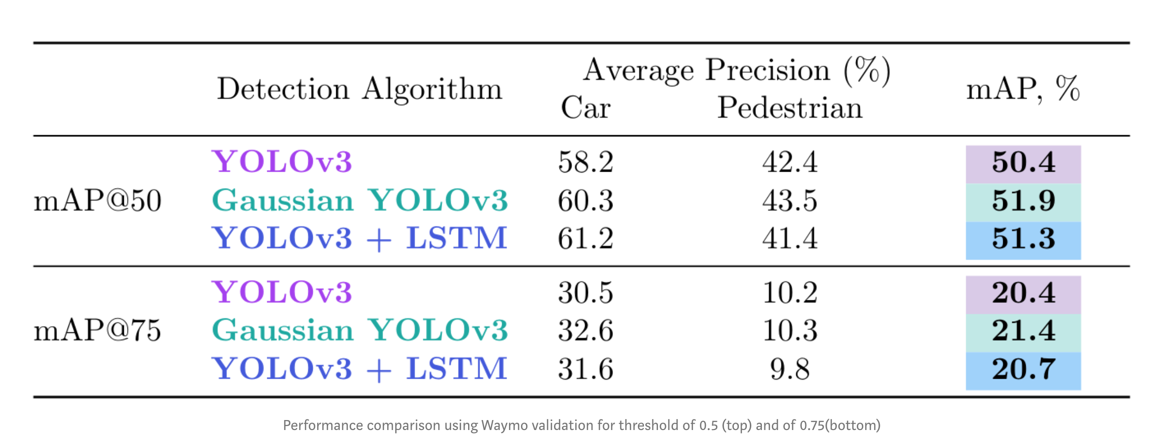
Training Result - mAP

Slide 11
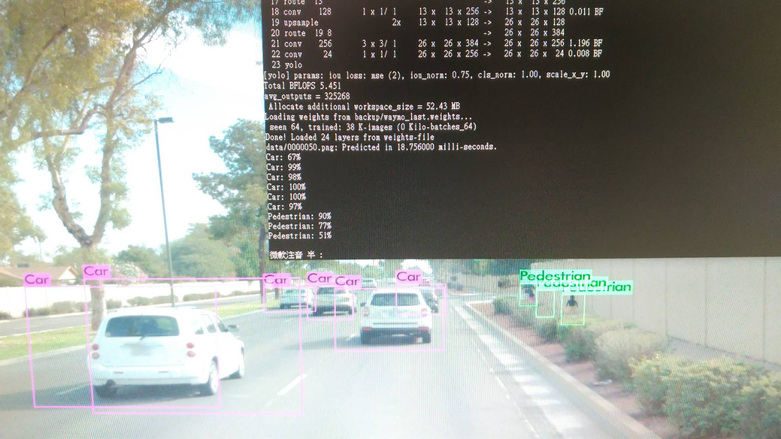
Detection Demo

Slide 12
Detection Demo

Slide 13
Thank you

Slide 14
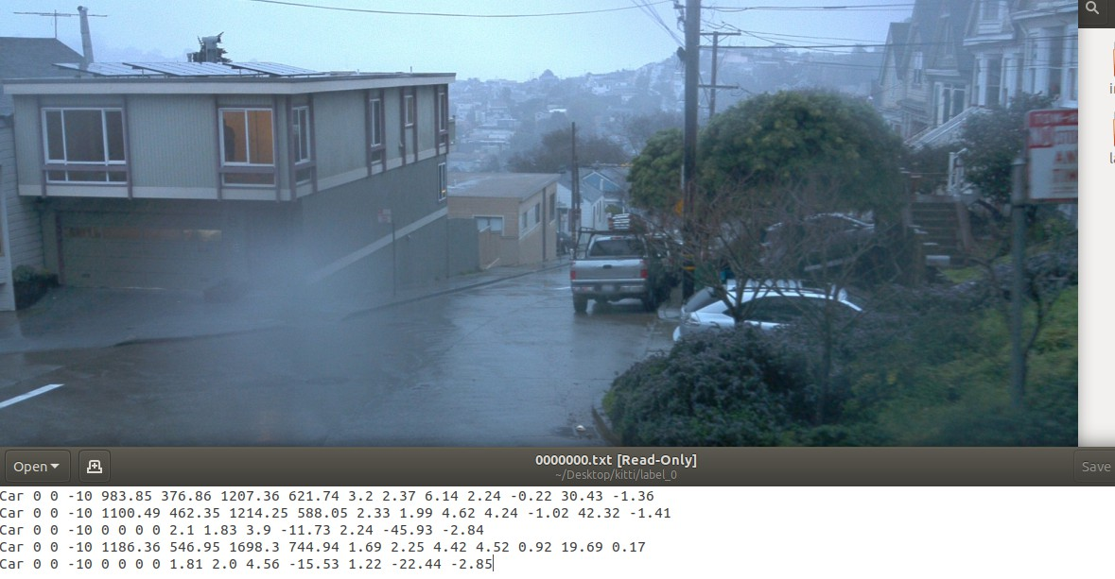
Data Preprocessing

Slide 15
Outline
Introduction
Data Preprocessing
Training model
mAP
Detection demo

